Slide 1


Class 1 Intro to SQL
Data Bhau
CLASS 1: SQL IN and OUT Workshop by DataBhau

Slide 2
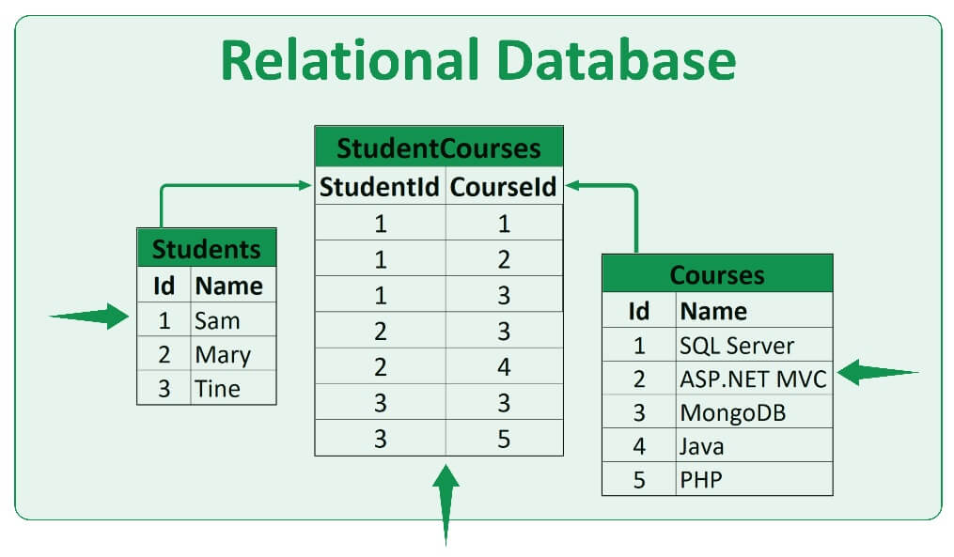
What are relational databases?
A relational database (RDB) is a way of structuring information in tables, rows, and columns. An RDB has the ability to establish links—or relationships–between information by joining tables, which makes it easy to understand and gain insights about the relationship between various data points.
CLASS 1: SQL IN and OUT Workshop by DataBhau

Slide 3
What is SQL Used for?
• SQL is used for database communication.
• It also helps in the creation, storage, and relational database functions of view.
• Use SQL to analyze and report data.
• It allows SQL users to construct the database and its tables, delete and edit it.
• To do data transformations.
• Use SQL to produce reports.
• The structured data can be described by it.
• SQL is used for inserting, updating, and deleting data.
CLASS 1: SQL IN and OUT Workshop by DataBhau

Slide 4
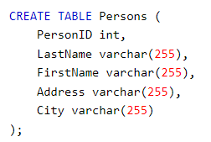

CREATE TABLE STATEMENT
The CREATE TABLE statement is used to create a new table in the database.
SYNTAX 1: Create table manually
CREATE TABLE table_name ( column1 datatype, column2 datatype, column3 datatype, .... );
SYNTAX 2: Create table using another table
CREATE TABLE new_table_name AS SELECT column1, column2,... FROM existing_table_name WHERE ....;
CLASS 1: SQL IN and OUT Workshop by DataBhau

Slide 5
INSERT INTO STATEMENT
The INSERT INTO statement is used to insert new records into a table.
SYNTAX 1: Insert manually
(Selected Columns)
INSERT INTO table_name (column1, column2, column3, ...) VALUES (value1, value2, value3, ...);
SYNTAX 3: Insert using a table
INSERT INTO table_name Select * from table_2
SYNTAX 2: Insert manually
(All Columns)
INSERT INTO table_name VALUES (value1, value2, value3, ...);
CLASS 1: SQL IN and OUT Workshop by DataBhau

Slide 6
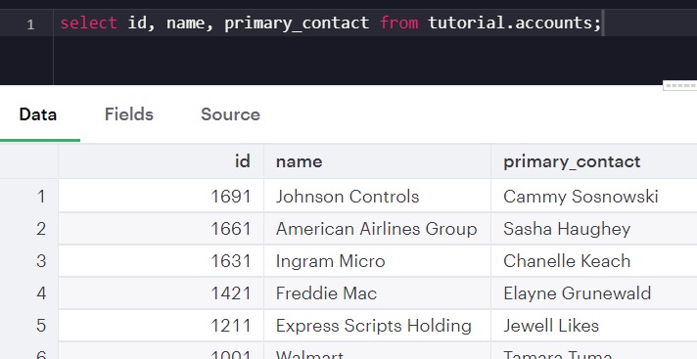
SELECT STATEMENT
The “SELECT” statement is used to select data from a database.
Using Select statement we can retrieve all/any columns from the mentioned table.
For eg:-
SELECT column1, column2 FROM table_name
SELECT * from table_name
CLASS 1: SQL IN and OUT Workshop by DataBhau

Slide 7
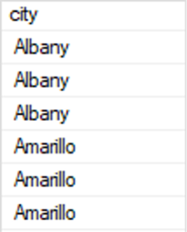
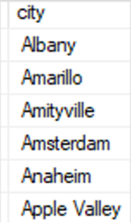
Finding Unique Values
Distinct keyword is used in SQL to find out the “unique values” in a particular column of a database
Without Distinct
With Distinct
SELECT city
FROM sales.customers
ORDER BY city
SELECT DISTINCT city
FROM sales.customers
ORDER BY city
CLASS 1: SQL IN and OUT Workshop by DataBhau

Slide 8
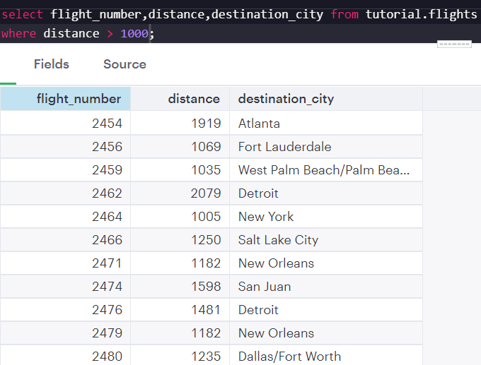
WHERE Clause
Where statement is used to extract particularly those rows that fulfill the mentioned conditions.
For eg:-
Select coumn_1,column_2 from table_name where Column_1 > 300
CLASS 1: SQL IN and OUT Workshop by DataBhau

Slide 9
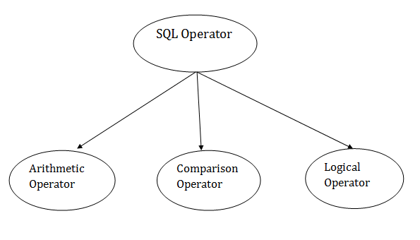
Operators in SQL
CLASS 1: SQL IN and OUT Workshop by DataBhau

Slide 10
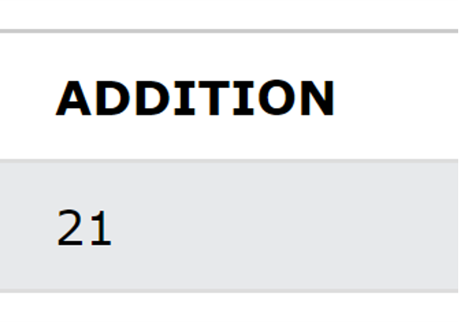
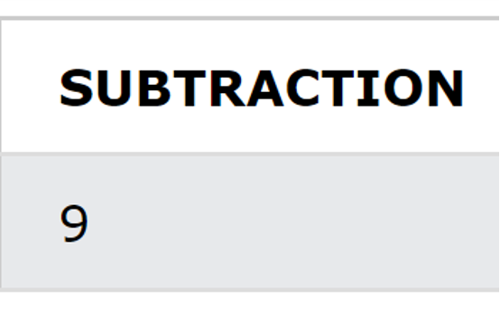
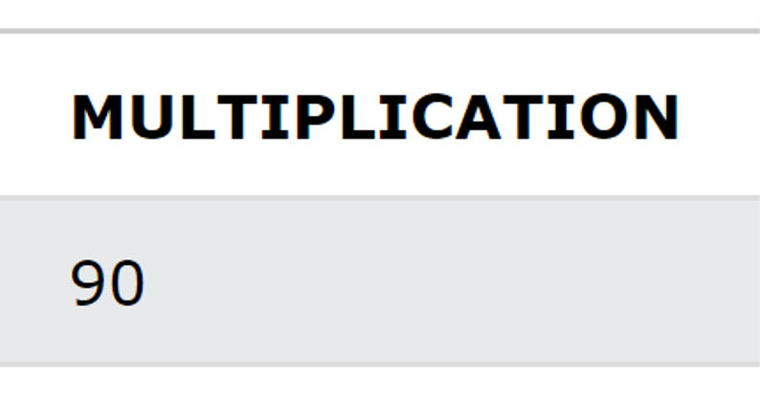
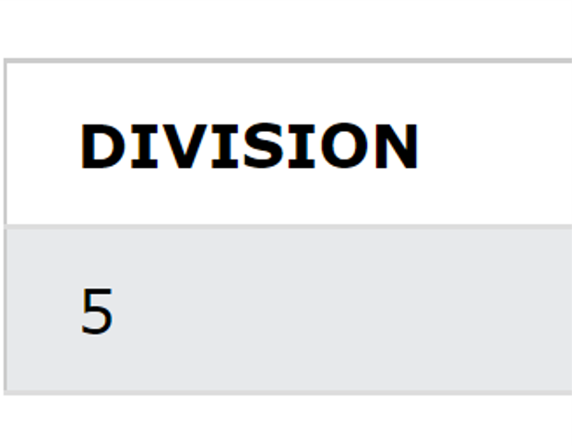
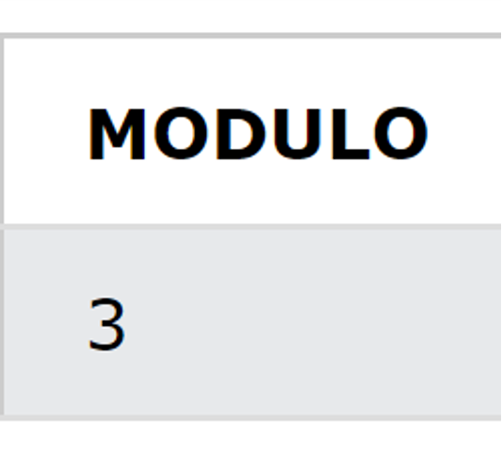
Arithmetic Operators
Operator Name | Operator Symbol | Example Query | Output Result
Addition | + | SELECT (15 + 6) AS ADDITION
Subtraction | - | SELECT (15 - 6) AS SUBTRACTION
Multiplication | * | SELECT (15 * 6) AS MULTIPLICATION
Division | / | SELECT (15 / 3) AS DIVISION
Modulo | % | SELECT (15 % 4) AS MODULO
CLASS 1: SQL IN and OUT Workshop by DataBhau

Slide 11
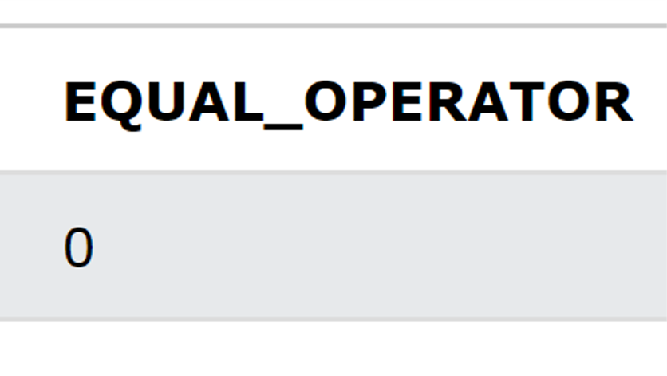
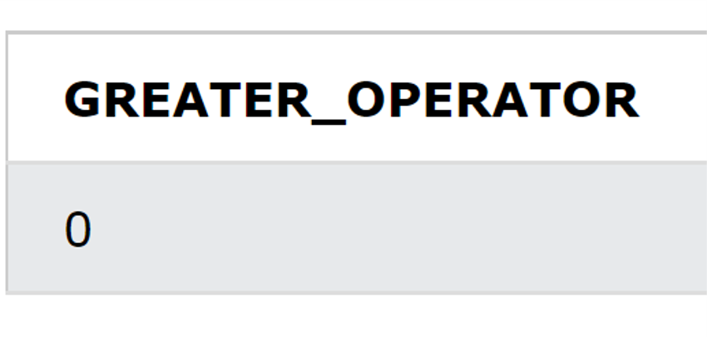
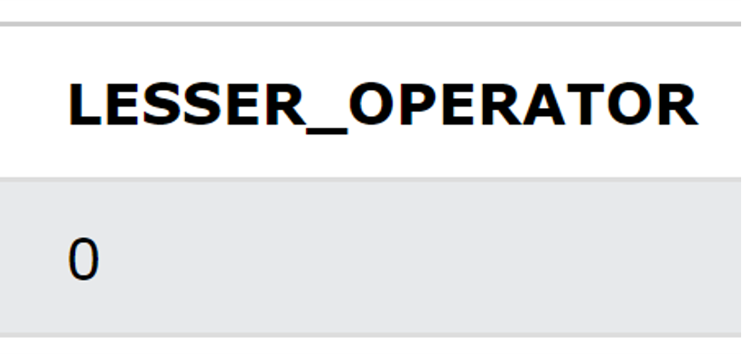
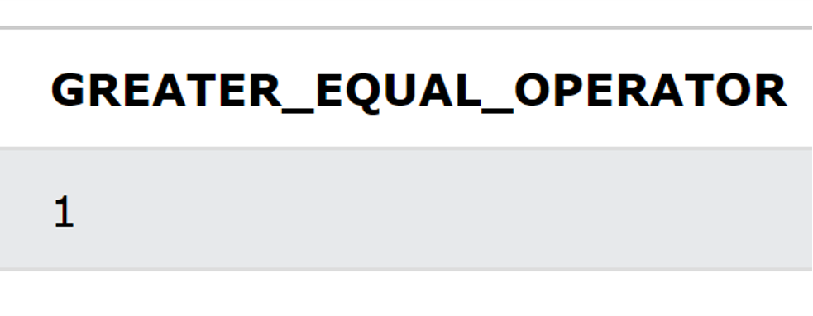
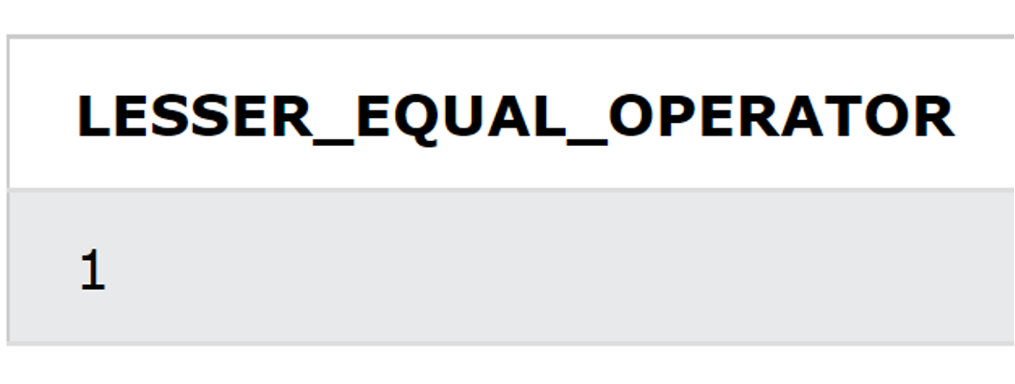
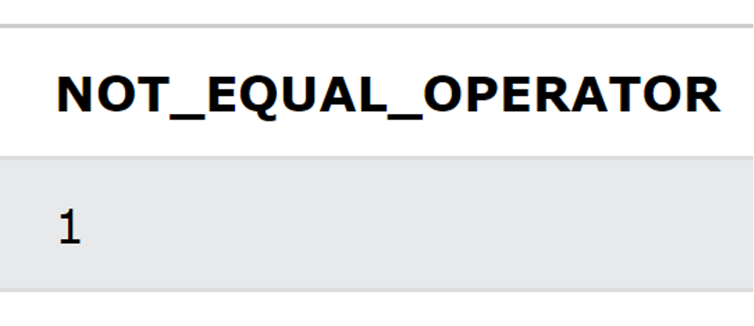
Comparison Operators
Operator Name | Operator Symbol | Example Query | Output Result
Equal to | = | SELECT (11 == 6) AS EQUAL_OPERATOR
Greater than | > | SELECT (11 > 6) AS GREATER_OPERATOR
Less than | < | SELECT (11 < 6) AS LESSER_OPERATOR
Greater than or Equal to | >= | SELECT (11 >= 6) AS GREATER_EQUAL_OPERATOR
Less than or Equal to | <= | SELECT (11 <= 6) AS LESSER_EQUAL_OPERATOR
Not Equal to | <> or != | SELECT (11 <> 6) AS NOT_EQUAL_OPERATOR
CLASS 1: SQL IN and OUT Workshop by DataBhau

Slide 12
Logical Operators
Operator Name | Operator Definition
AND | True is all conditions separated by AND are ture
BETWEEN | True if operand is within the range of comparisons
IN | True is operand is equal to one of a list of expressions
LIKE | True if operand matches a pattern
NOT | True if a condition is NOT True.
OR | True if any of the conditions separated by OR are True.
CLASS 1: SQL IN and OUT Workshop by DataBhau

Slide 13
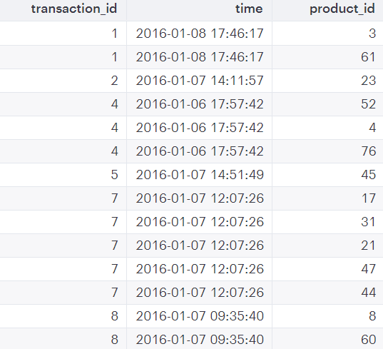
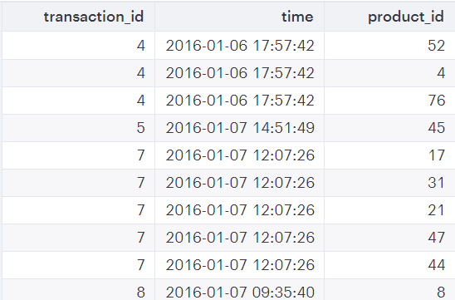
AND Operator
Query Execution
select * from tutorial.excel_sql_transaction_data WHERE transaction_id > 2 and product_id > 2
BEFORE EXECUTION
AFTER EXECUTION
Query Executed
CLASS 1: SQL IN and OUT Workshop by DataBhau

Slide 14
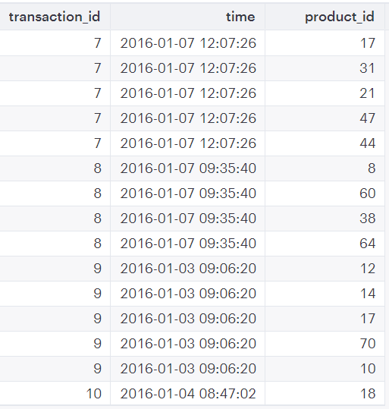
BETWEEN Operator
Query Execution
select * from tutorial.excel_sql_transaction_data WHERE transaction_id between 7 and 10
BEFORE EXECUTION
AFTER EXECUTION
Query Executed
CLASS 1: SQL IN and OUT Workshop by DataBhau

Slide 15
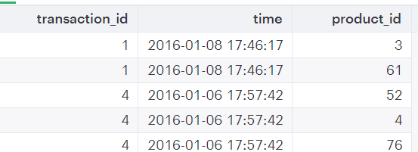
IN Operator
Query Execution
select * from tutorial.excel_sql_transaction_data WHERE transaction_id in (1,4,6)
BEFORE EXECUTION
AFTER EXECUTION
Query Executed
CLASS 1: SQL IN and OUT Workshop by DataBhau

Slide 16
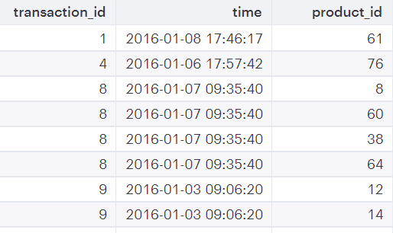
OR Operator
Query Execution
select * from tutorial.excel_sql_transaction_data WHERE transaction_id > 7 or product_id > 60
BEFORE EXECUTION
AFTER EXECUTION
Query Executed
CLASS 1: SQL IN and OUT Workshop by DataBhau

Slide 17
SQL Wildcards
Operator Name | Operator Definition | Example
% | Represents Zero or more characters | bl% finds bl, black, blue, bloom.
_ | Represents a Single character | C_p finds cap,cup.
[] | Represents any single character within brackets | G[oa]t finds got, gat
^ | Represents any character not within brackets | G[^oa]t finds git but not got and gat
- | Represents any single character within the specified range | C[a-b]t finds cat and cbt
CLASS 1: SQL IN and OUT Workshop by DataBhau

Slide 18
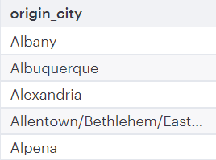

SQL Wildcards – Examples
select DISTINCT origin_city from tutorial.flights where origin_city like 'Al%'
select DISTINCT origin_state from tutorial.flights where origin_state like 'Oh__'
CLASS 1: SQL IN and OUT Workshop by DataBhau

Slide 19
Thanks for attending
You can reach out to us at:
Whatsapp : https://chat.whatsapp.com/BaP2CAajm9597J8LwzYE3j
Linkedin Handle: https://www.linkedin.com/company/databhau/
Instructors Linkedin Handles:
Shrey Jain : https://www.linkedin.com/in/shrey-jain-74a90b13b/
Harsh Katyayan : https://www.linkedin.com/in/harsh-katyayan-a2248316b/
CLASS 1: SQL IN and OUT Workshop by DataBhau

